Slide 1

DATA SCIENCE PROJECT – PRCL-0019: SALES EFFECTIVENESS
Client: FicZon Inc. (IT Solutions Provider)
Team Code: PTID-AIE-JUL-26-11142
Submitted By: Sameeksha

Slide 2
TABLE OF CONTENTS
01 Project Overview & Objectives
02 Dataset Overview
03 Exploratory Data Analysis (EDA)
04 Data Cleaning & Preprocessing
05 Target Variable Creation
06 Machine Learning Models
07 Hyperparameter Tuning
08 Model Performance Comparison
09 Overfitting Diagnostics
10 Feature Importance
11 Business Insights & Challenges
12 Project Links & Conclusion

Slide 3
1. PROJECT OVERVIEW & OBJECTIVES
The Problem:
FicZon Inc. generates the majority of its IT product leads through digital channels (website).
Market maturation and new competitors have caused a dip in sales.
Lead categorization is currently a manual, post-analysis process that fails to support real-time conversion decisions.
Business Objective:
Leverage Machine Learning to pre-categorize lead quality at the exact point of capture to dramatically increase sales effectiveness.
Project Goals:
Extract clear data exploration insights related to sales patterns.
Build a robust classification model to predict lead potential (High Potential vs. Low Potential) so agents can prioritize high-value deals.

Slide 4
2. DATASET OVERVIEW
Key Features:
Created (Timestamp)
Product_ID (Product Identifier)
Source (Lead Acquisition Channel)
Mobile / EMAIL (Customer Contact Flags)
Sales_Agent (Assigned Sales Representative)
Location (Geographic Region)
Delivery_Mode (Product Delivery Setup)
Status (Raw Outcome - used to build the target variable)
Data Source: MySQL Database — project_sales.data (DataMites™ Project Server).
Dataset Size: 7,422 records across 9 features.
Data Types: A mix of categorical identifiers, timestamps, and contact fields.

Slide 5
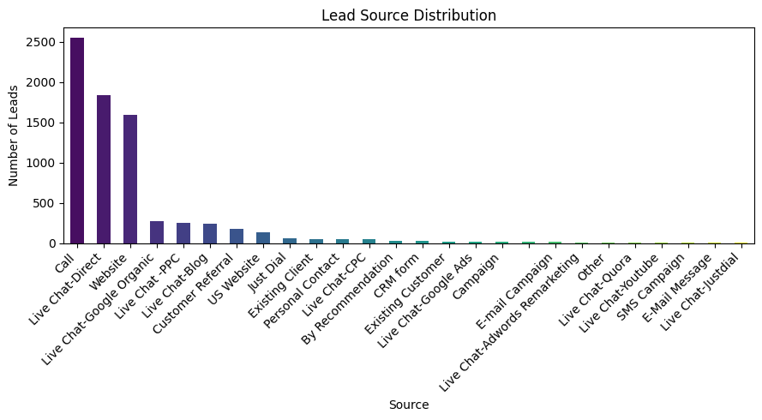
3. EXPLORATORY DATA ANALYSIS (EDA) – VISUALIZING INSIGHTS

Slide 6
4. DATA CLEANING & PREPROCESSING
1.Null Value Treatment:
Small missing counts in Source, Sales_Agent, Location, and Mobile were explicitly filled with the category 'Unknown' to preserve rows and treat missingness as a predictive signal.
Product_ID blanks were converted to numeric values and imputed using the median.
2.Outlier Capping (Winsorization):
Identified 107 outlier rows in Product_ID using the IQR method.
Values were clipped at the IQR fences rather than deleted, keeping the row count intact.
3.Final Cleaned Dataset Shape: 7,420 rows, 9 columns.

Slide 7
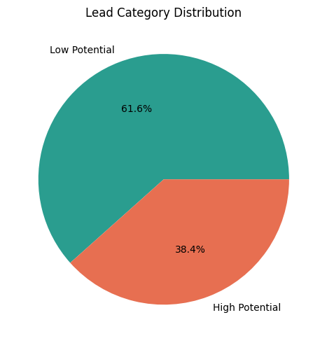
5. TARGET VARIABLE CREATION
The Challenge: No ready-made target column existed. The raw Status column contained case-sensitive, highly granular strings.
The Root Cause Fix: Corrected a critical mapping error where mismatched placeholder string keys originally caused all rows to collapse into a single category.
The Strategic Mapping:
High Potential: CONVERTED, converted, In Progress Positive, Potential, Long Term.
Low Potential: In Progress Negative, Not Responding, Just Enquiry, Junk Lead, LOST, Open.
Final Class Balance: Balanced and viable for modelling:
Low Potential: 4,571 records (61.6%)
High Potential: 2,849 records (38.4%)

Slide 8
6. FEATURE ENGINEERING
Temporal Features: Broken Created timestamp down into Created_Year, Created_Month, and Created_Day to unlock seasonal and daily transaction trends.
Contact Quality Indicators:
Transformed raw Mobile numbers into a binary flag: Has_Mobile (0 for unknown/blank, 1 for provided).
Transformed EMAIL into Has_Email (0 or 1).
Leakage Prevention: Dropped the raw Status column entirely before training to ensure the model evaluates leads purely on characteristics available at the time of capture.

Slide 9
7. MACHINE LEARNING MODELS EVALUATED
The Strategy: Explored five distinct classification algorithms to identify the best balance of variance and bias.
The Models:
Logistic Regression: Regularized with an L2 penalty (C=0.5) and balanced class weights.
Decision Tree Classifier: Pruned heavily (max_depth=6, min_samples_leaf=20) to prevent data memorization.
Random Forest Classifier: Ensembled tree architecture built to resist noise via depth constraints.
K-Nearest Neighbours (KNN): Distance-based cluster checking using an expanded neighborhood (k=15).
Gradient Boosting Classifier: Sequential ensemble optimized using stochastic boosting (subsample=0.8) and a conservative learning rate (0.05).

Slide 10
8. HYPERPARAMETER TUNING
Approach: Ran a 5-fold stratified cross-validation via GridSearchCV on the Random Forest architecture to optimize the model without leaking data.
Param Grid Tested: n_estimators, max_depth, min_samples_split, and min_samples_leaf.
Optimal Parameter Selection:
max_depth: 12
min_samples_leaf: 5
min_samples_split: 5
n_estimators: 100
Result: Successfully stabilized the random forest against high-cardinality sparse columns.

Slide 11
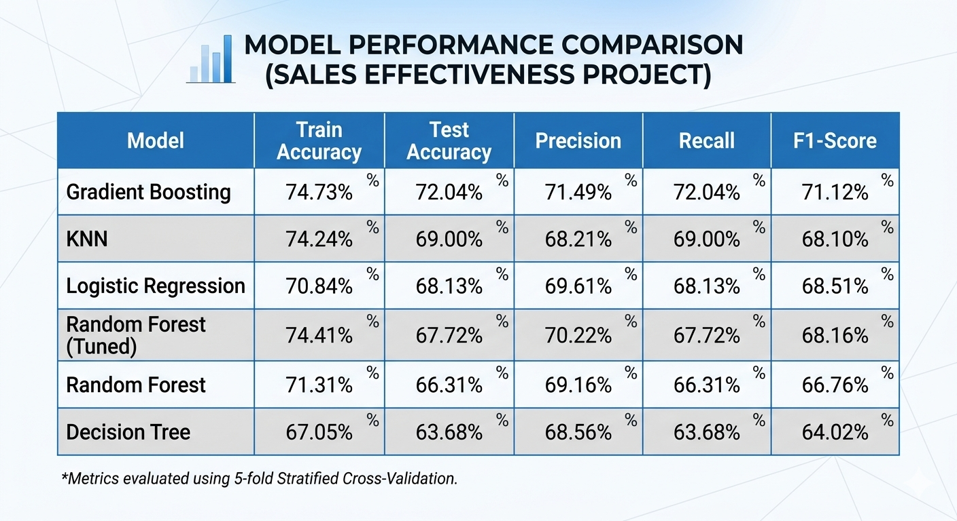
9. MODEL PERFORMANCE COMPARISON

Slide 12
10. OVERFITTING DIAGNOSTICS & FINAL SELECTION
The Diagnostic Metrics: Verified generalization capabilities using 5-Fold Cross-Validation vs Train-Test margins.
Winner Selection: Gradient Boosting achieved the highest test accuracy (72.04%) and best F1-Score (71.12%) while maintaining an incredibly tight Train-Test gap of just 2.70%.
Visual Anchor: Confusion Matrix showing strong true positive and true negative classification counts for the Gradient Boosting model.

Slide 13
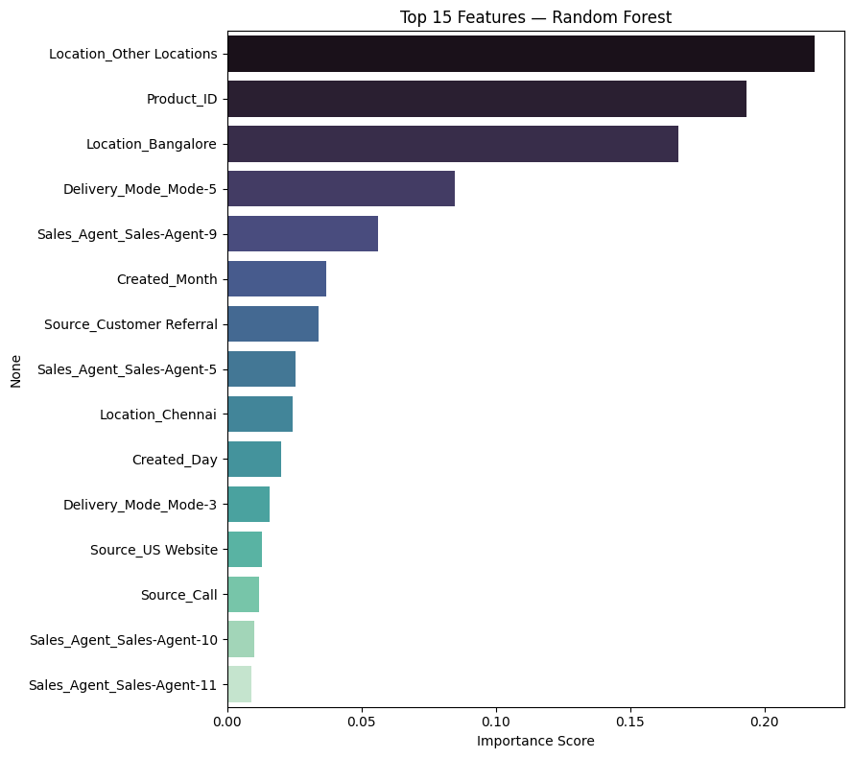
11. FEATURE IMPORTANCE

Slide 14
12. BUSINESS INSIGHTS & ACTIONABLE IMPACT
Real-Time Funnel Optimization: By deploying the Gradient Boosting model at lead capture, agents can stop manually parsing portfolios and instantly prioritize High Potential leads.
Balancing Workloads: Address the massive pipeline variance where certain agents handle too many leads, degrading response times and lowering close rates.
Geographic Allocations: Shift marketing capital toward high-performing zones like Bangalore and optimize strategies for "Other Locations".
Product-Focused Sales Triggers: Align specialized sales experts to handle leads showing interest in top-converting Product_ID numbers.

Slide 15
13. CHALLENGES FACED & SOLUTIONS
Target Missingness & Leakage: Resolving the initial string-matching mismatch that caused all target classes to drop into a single value, making early model validations useless.
High Cardinality Constraints: Managing over 50 sparse columns generated by one-hot encoding categorical variables (Sales_Agent and Location) on a relatively compact dataset.
Imbalanced Outcomes: Handling the strong native tilt toward low-performing junk leads by introducing balancing constraints during training.

Slide 16
14. CONCLUSION & PROJECT LINKS
Project Conclusion:
Successfully built and deployed an automated lead pre-categorization pipeline.
Shifted FicZon’s strategy from retrospective analysis to real-time sales empowerment.
Code & Artifact Repositories:
🔗 GitHub Repository: https://github.com/Sameekshagithub/PRCL-0019-Sales-Effectiveness-Lead-Category-Prediction-Using-Machine-Learning.git
🔗 Google Drive Folder: https://drive.google.com/drive/folders/1VE1wgDlXmQN1fXl-I-5Ymj2P8KUPEK49?usp=drive_link

Slide 17
THANK YOU!!

